Slide 1
Multi-Satellite Fire Detection Composite FRED
CSB Meeting
17 Mar 2020

Slide 2
Progress Update
Sun glint filter for Himawari-8/9
Use of logistic regression
Validation Results
New approach in ground-truthing

Slide 3
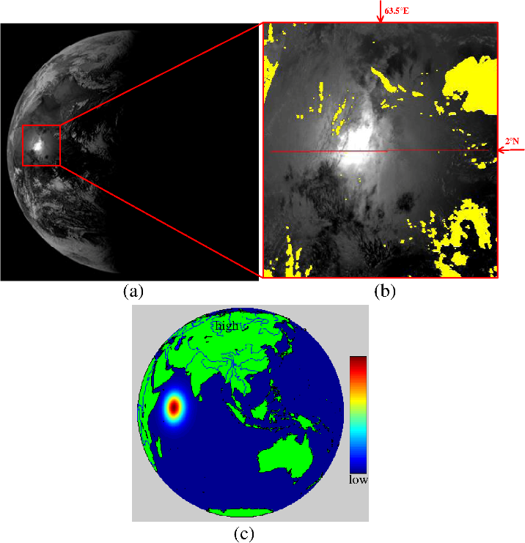
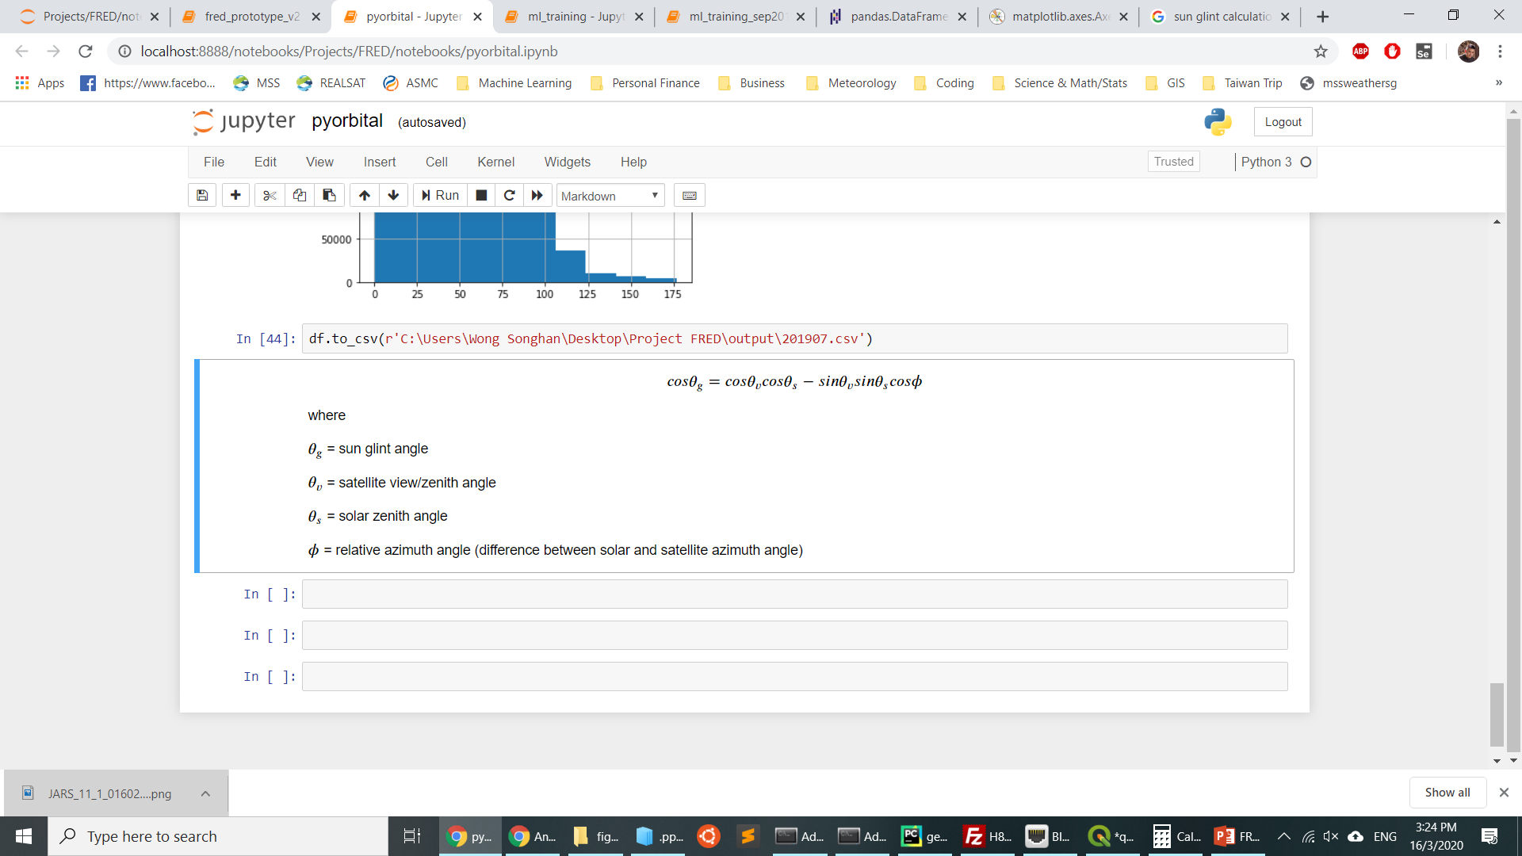
Himawari-8/9 Sun Glint Rejection
Sun glint angle
the angle difference between reflected solar beam and the satellite view/zenith angle, from the satellite reference frame. If the angle is small, it means that the outgoing solar reflection is directed at the sensor of satellite.
Calculation done using pyorbital and satellite metadata

Slide 4
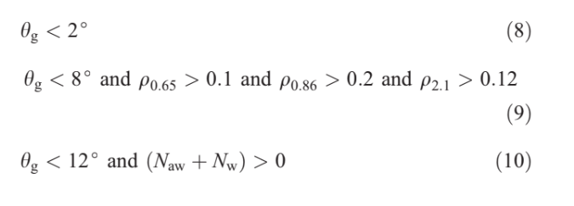
Himawari-8/9 Sun Glint Rejection
The following rules are used in the MODIS/VIIRS fire detection algorithm
Opt for a simple thresholding method in (8)
Criterion (9) and (10) involves processing of original HSD data, efforts akin to producing fire hotspot product ourself
For more info, refer to "An Enhanced Contextual Fire Detection Algorithm for MODIS" by Louis Giglio et al 2003
https://doi.org/10.1016/S0034-4257(03)00184-6

Slide 5
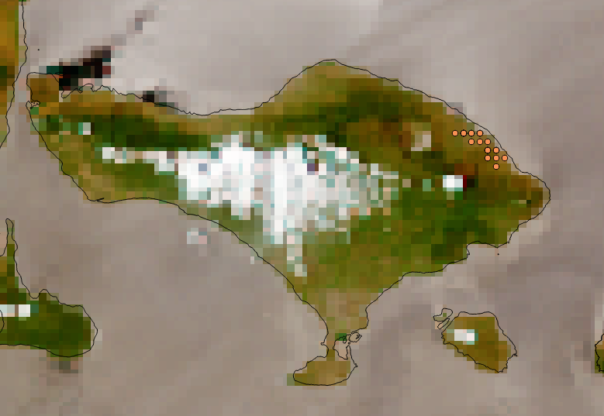
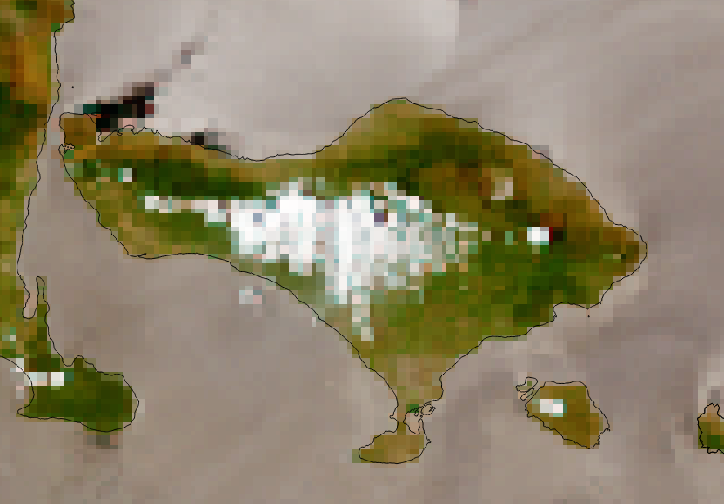
Himawari-8/9 Sun Glint Rejection
Very effective in eliminating sun-glint induced fire hotspots
Initial exploration found that majority of false alarms can be easily rejected
Optimal threshold is determined during the validation phase
Before
After

Slide 6
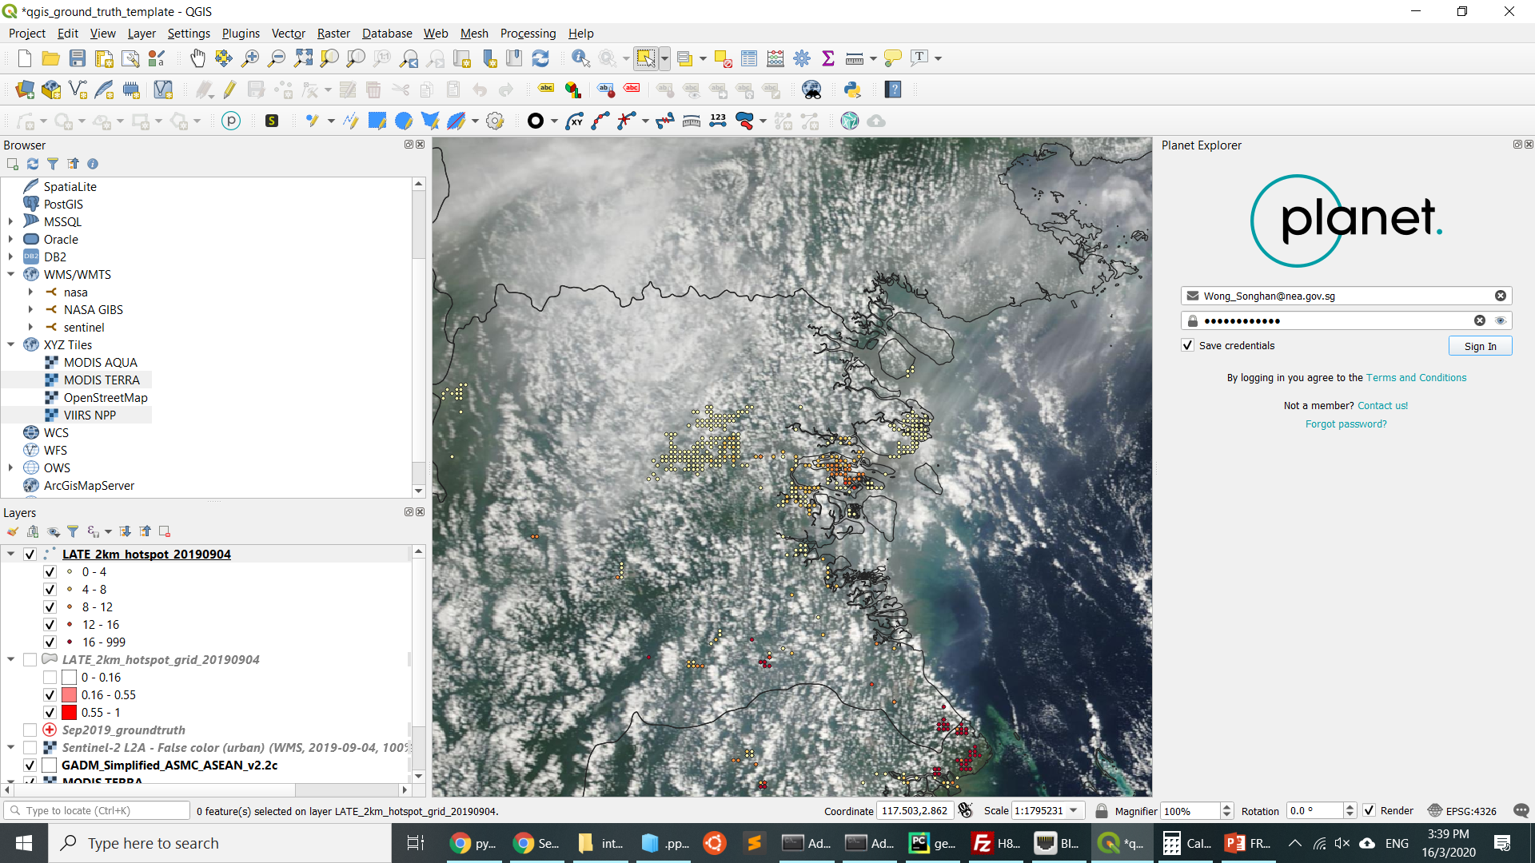
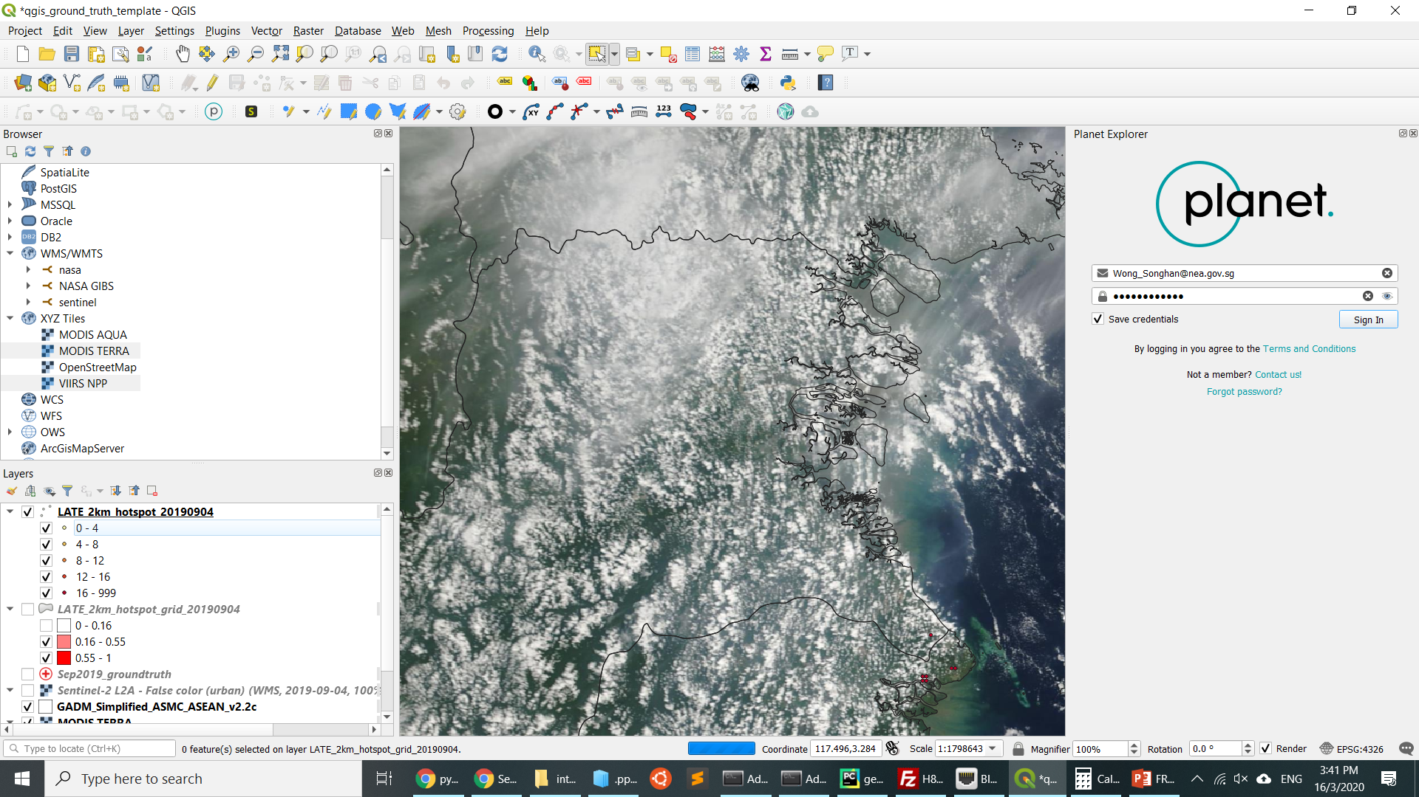
H-8 hotspots at different sun glint angles
Sun glint angle

Slide 7
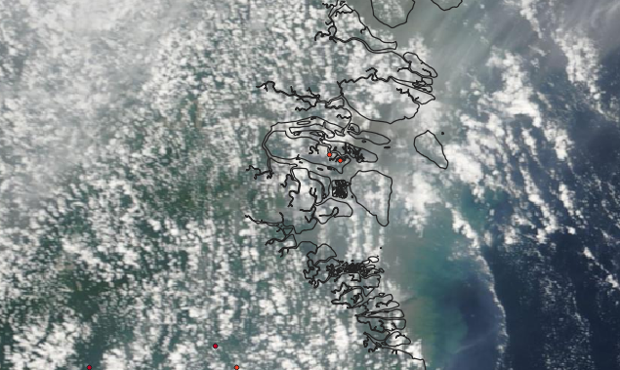
Sun glint induced hotspots removed (minimum angle of 12º)
Sun glint angle

Slide 8
Overview
Satellite hotspot data
TERRA
AQUA
Pre-processing
Sun glint filter
Machine Learning Model
Logistic Regression
Training & Validation
NOAA-20
Suomi-NPP
Himawari-8
Regridding
Temporal Aggregation
Fitted parameters for Logistic Regression model
Find optimal parameters for sun glint angle, hotspot weight
Final Product
Probabilistic estimates for fire hotspot grid
Feature Engineering
Compute hotspot weight

Slide 9
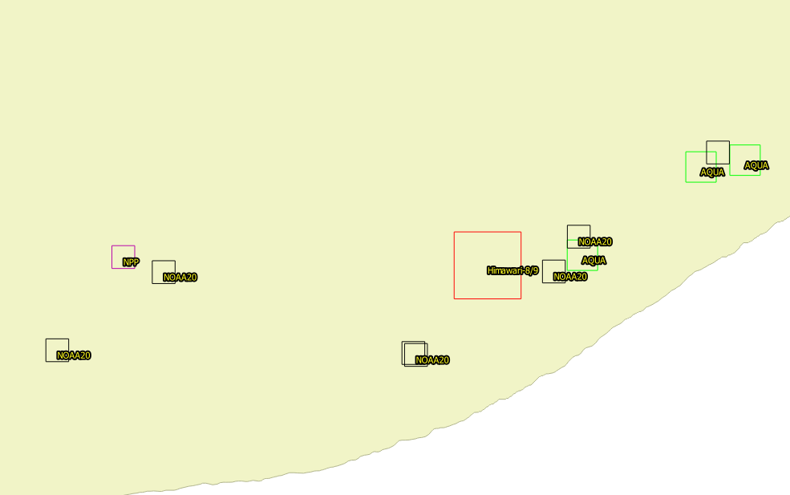

Regridding
Hotspots from different sensors
Different satellite hotspot data has different resolutions or grid size (0.75 - 2 km)
Harmonisation to standardise grid resolution
All data is gridded to 2 km resolution
Regridded

Slide 10

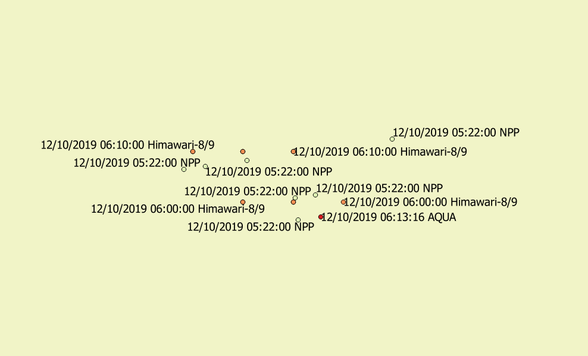
Temporal Aggregation
11.30 am
1 pm
2 pm
2.30 pm
TERRA
AQUA
NOAA-20
Suomi-NPP
Himawari-8
Himawari-8
Himawari-8
8 am
12.50 pm
3 pm
Aggregate fire hotspot detected within a certain observation window period
Observation period used:
00:00 – 08:30 UTC
Aggregated Hotspots (00 – 09 UTC)

Slide 11
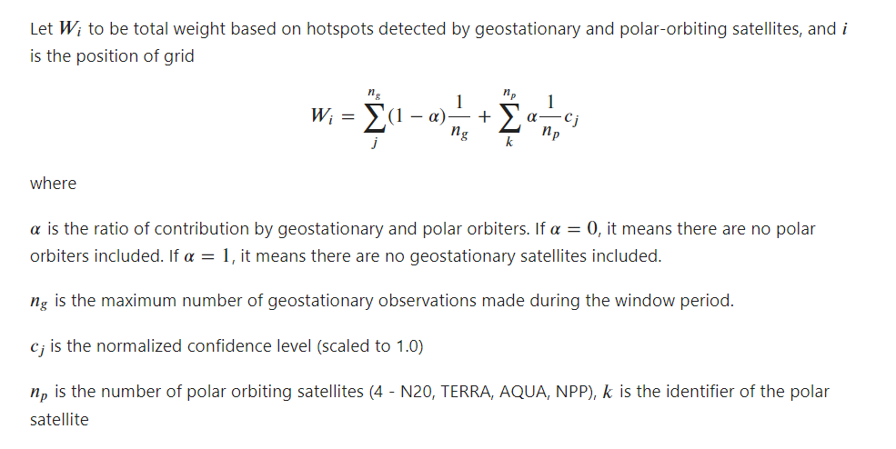
Feature Engineering – Hotspot Weight

Slide 12
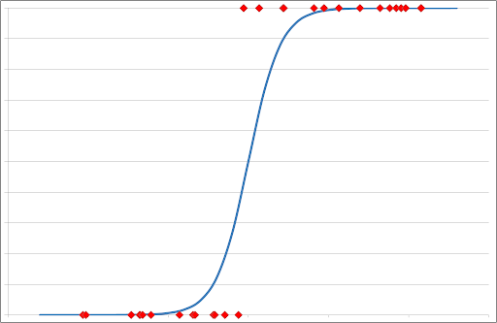
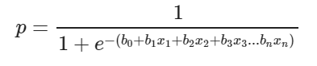
Machine Learning – Logistics Regression
Probability
Real fire
1.0
False detection
0.0
1.0
Normalised hotspot weightage per grid
Probabilistic version of linear regression y = mx + c
Simple model for easy interpretation
Source: towardsdatascience.com

Slide 13
Model Training, Verification & Validation
Purpose:
To fit the logistic regression curve with the data
Find optimal parameters for
Alpha – weight ratio of polar and geostationary satellite hotspot
Sun glint angle
Group A: July 2019 ground-truth data prepared by Effy
Used earlier for N20 validation
Early part of hotspot season
Sentinel-2 data and NUS CRISP
Date of burning estimated based on burnt mark
Num of labels - 342
Group B: 1-4 Sep 2019
Peak of hotspot season
Integrated various API/plugins on QGIS to visualize sat data very quickly
Sentinel-2, NUS CRISP, MODIS, VIIRS, Planet
Less uncertainty with date of burning estimation
Num of labels – 622

Slide 14
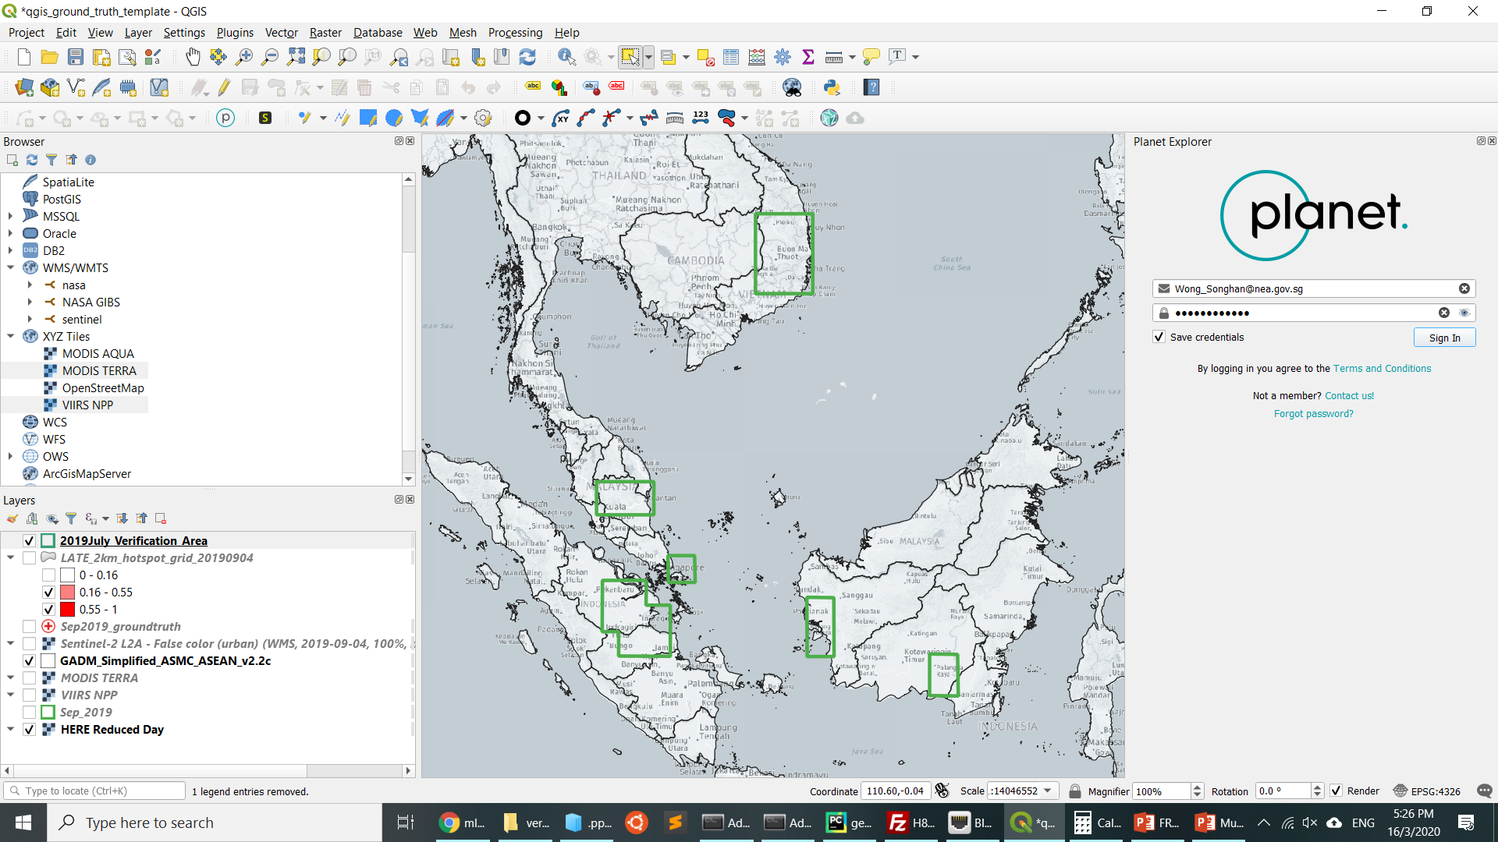
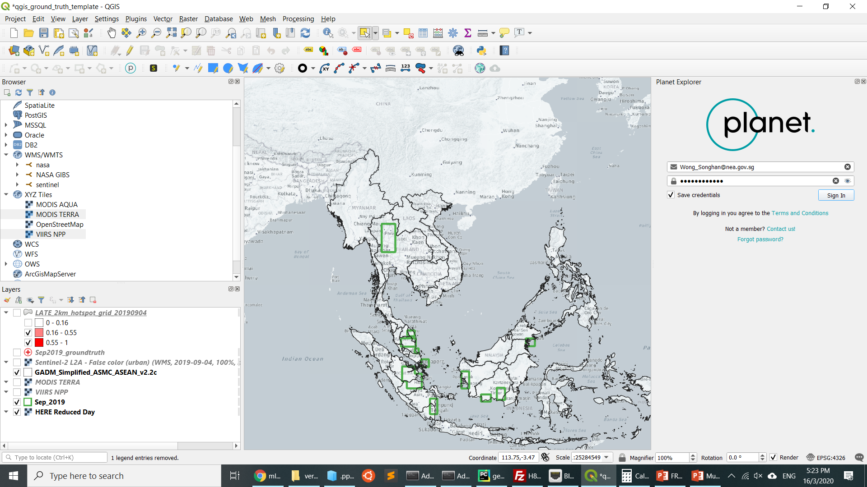
Group A: July 2019
Verification Area
Group B: 1- 4 Sep 2019

Slide 15
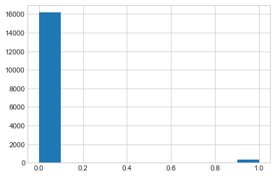
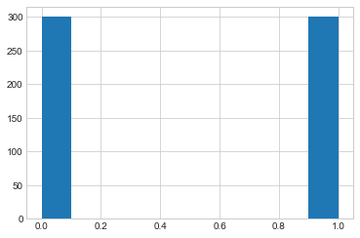
Handling of validation data
Class imbalance problem
Number of false alarms > number of true positive
Resampling is done to ensure 50:50 ratio
1 km buffer is added for verification
75:25 split for training and test data
Before resampling
After resampling
Non-fire
Fire
Non-fire
Fire

Slide 16
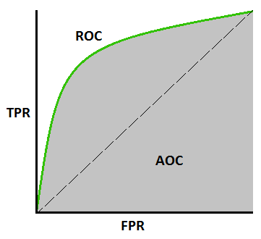
ROC = Area under the curve
1.0 is perfect, 0.5 is no better than random guess.

Slide 17
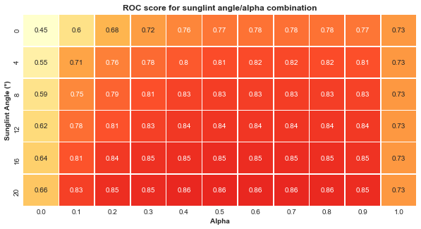
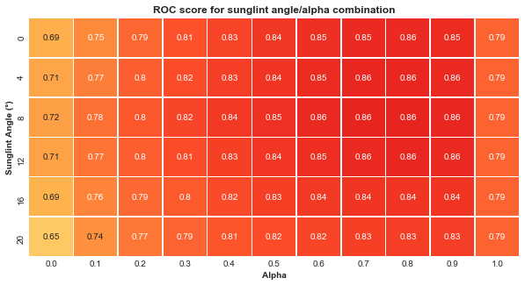
Model Training, Verification & Validation
Group A: July 2019
Performance of a hotspot composite is clearly better than using solely geostationary or polar-orbiting satellite
Improvement in score shown when sunglint filter is applied
Choice of optimal parameter of alpha and sun glint angle sensitive to training data
(training data not representative enough yet)
Group B: 1- 4 Sep 2019

Slide 18
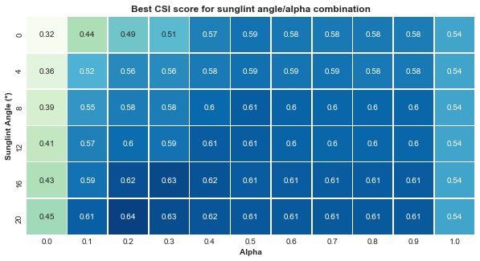
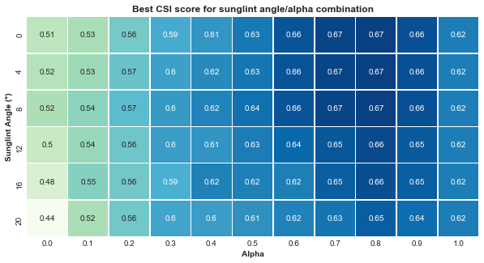
Model Training, Verification & Validation
Group A: July 2019
Group B: 1- 4 Sep 2019

Slide 19
Model Training, Verification & Validation
How to pick the optimal parameter ?
Group B: 1- 4 Sep 2019

Slide 20
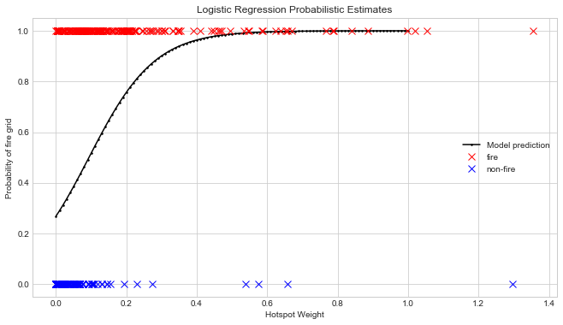
Model Training, Verification & Validation
Group B: 1- 4 Sep 2019

Slide 21
Model Training, Verification & Validation
Group B: 1- 4 Sep 2019
2 polar hotspots with 100% confidence
2 polar hotspots with 100% confidence + himawari-8 hotspot detected consecutively for 3 hours
1 single polar hotspot with 66% confidence

Slide 22
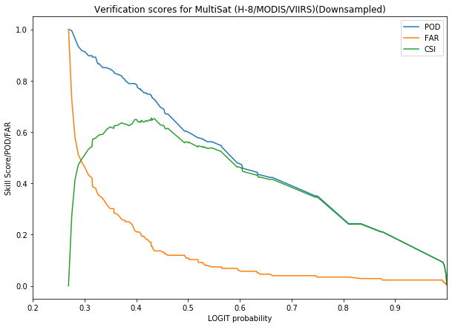
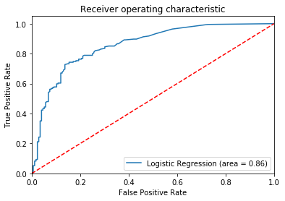
Model Training, Verification & Validation
Group B: 1- 4 Sep 2019

Slide 23
Conclusion
Multi-sat hotspot composite clearly superior over single source hotspot data
Sun glint filter brought major improvement
Optimisation of model parameters still on-going as they are sensitive to model data but modelling approach is more or less finalised

